Slide 1
ONLINE QUIZ PORTAL
Mentor – Mr . Virendra Dheru
-Vaibhav gupta - 179302173 -Vibhav srivastava – 179302164

Slide 2
INTRODUCTION
This is the era of computer and we are adopting fast mechanism to solve any problem. On line quiz is also a way to give result as soon as we submit our paper.
The online quiz portal will contain some security features like signup and login . Results will be stored in data which can be accessed by admin faculty and staff . There will a short report for students displayed after the test is over containing the marks of test.
Some features like countdown timer , auto saving , anti copying are present with this website . As the time gets over the quiz will be submitted on the stage it was . The count down timer can be set by the admin only and it cannot be manipulated by any other user.
This online quiz system solves a major problem of gathering and giving quiz on paper .Online quiz is conducting a test online to measure the knowledge of the participants on a given topic. In the olden days, everybody had to gather in a classroom at the same time to take an exam. With online examination students can do the exam online, in their own time, with their own device, regardless of where they live. You only need a browser and an internet connection

Slide 3
Objective
The main objective of this online quiz system is to reduce the work of conducting the quiz. The online quiz system is a web based application which is useful all over the educational sector.
Online examination will diminish the rushed occupation of evaluating the answers given by the applicants physically.
Being a coordinated Online examination framework it will decrease paper work.
To permit workforce to make tests and answer key.
To permit programmed reviewing and manual evaluating which can be recorded per test.

Slide 4
Scope
This System is cost-effective and is among popular means of mass evaluation.
It would provide with time-flexibility and also time-saving at the same time for proper quiz conduction.
It would release workload of admin/faculty promoting interactions among students and between the faculty & students.

Slide 5
DRAWBACKS OF EXISTING SYSTEM
1. Individual child statistics- the existing quiz portals don’t show the individual statistics of the child’s performance after every quiz.
2. As there is no private portal of university that can conduct online quizzes .So basically, our university does not have to rely on other third party online quiz portals.
3. User friendly environment.
4. The system is not able to provide feature of dynamic negative marking.
5. This portal will prevent copying of questions so that students cannot copy questions and google answers.

Slide 6
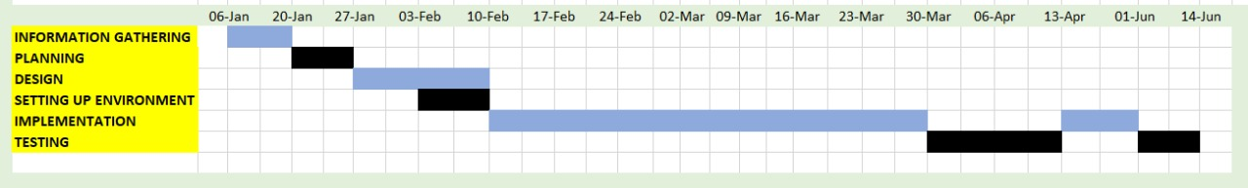
PROJECT PHASES

Slide 7
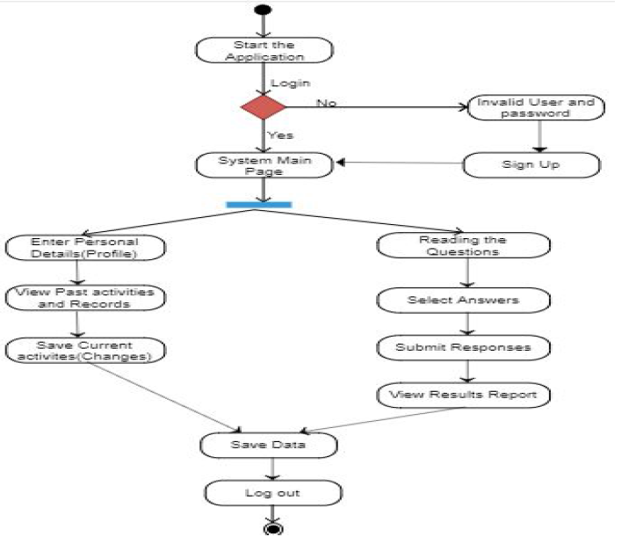
Activity Diagram

Slide 8
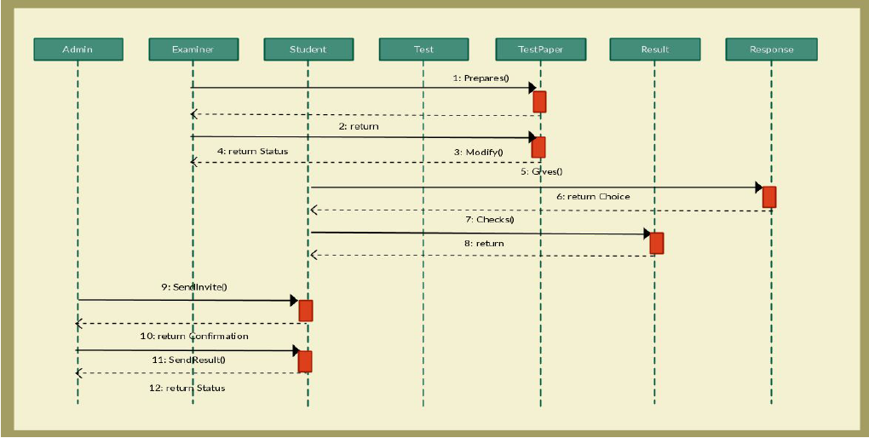
Sequence Diagram

Slide 9
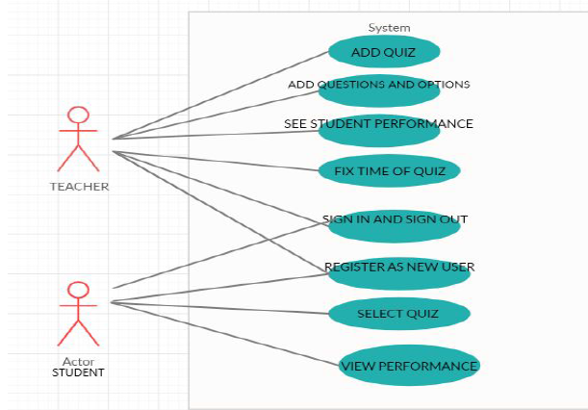
Use Case Diagram

Slide 10
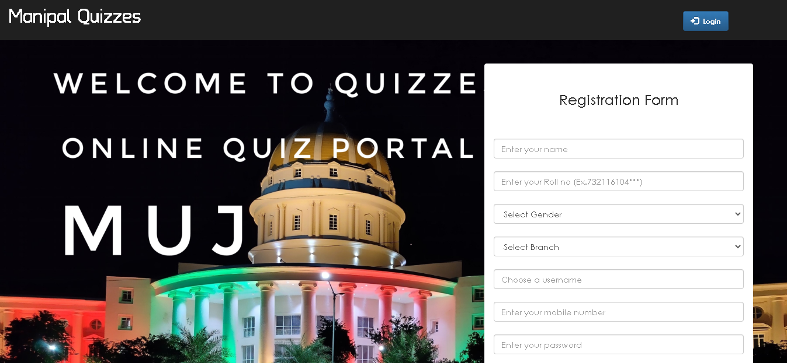
Sign Up Page

Slide 11
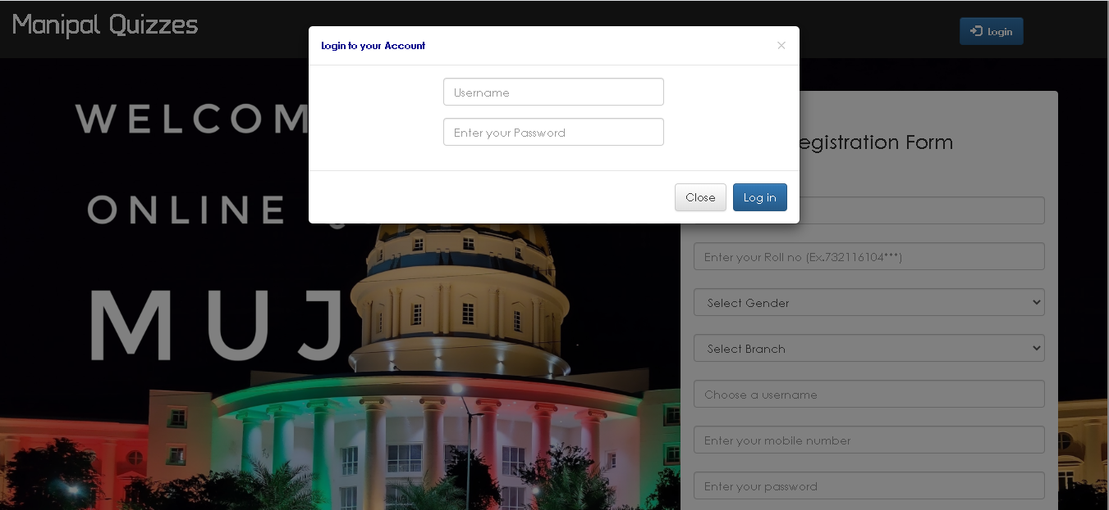
Login Page

Slide 12
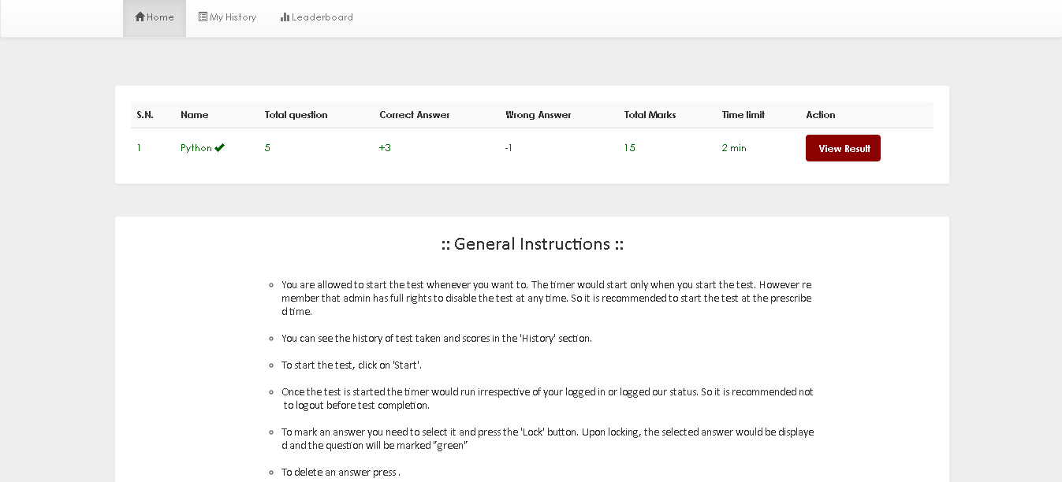
Home Page

Slide 13
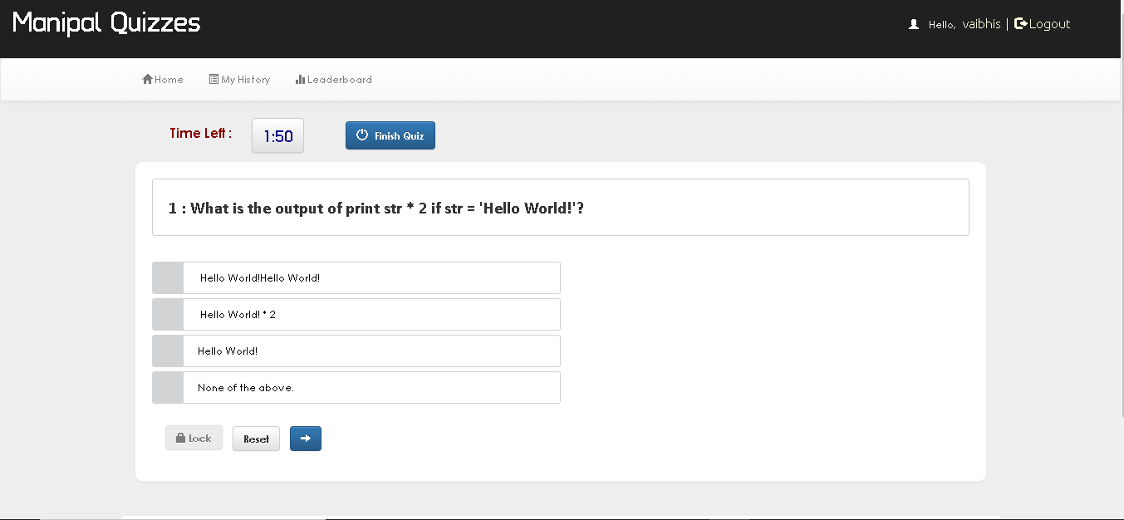
Quiz Page

Slide 14
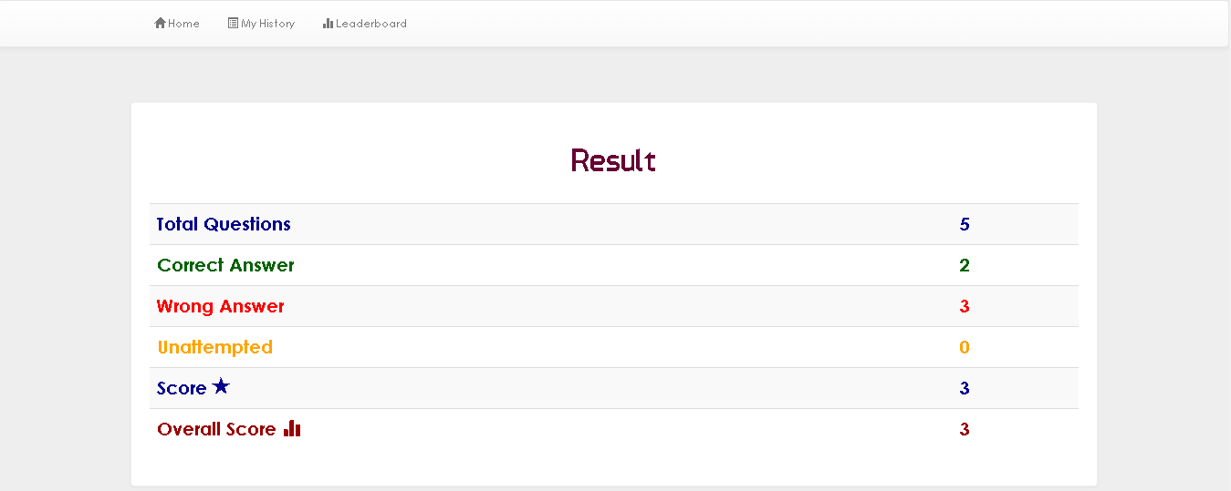
Result Page

Slide 15
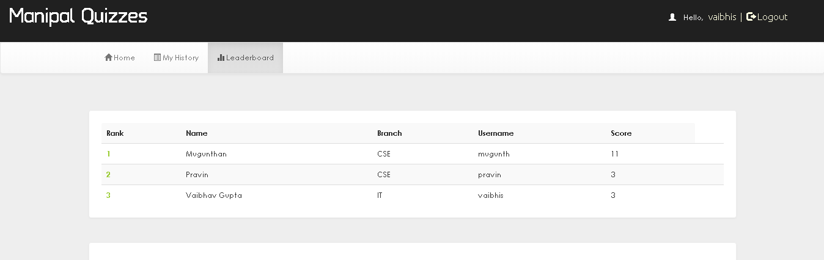
Leaderboard Page

Slide 16
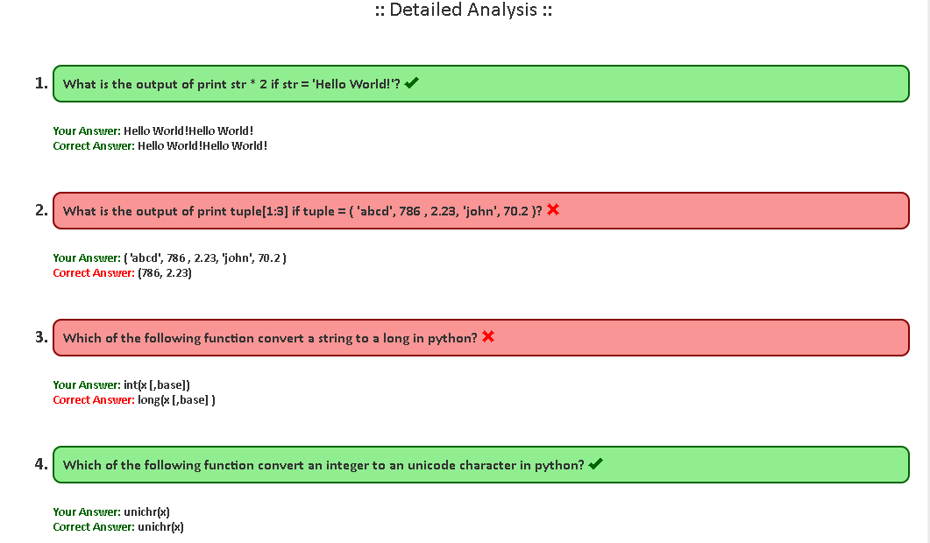
Analysis Page

Slide 17
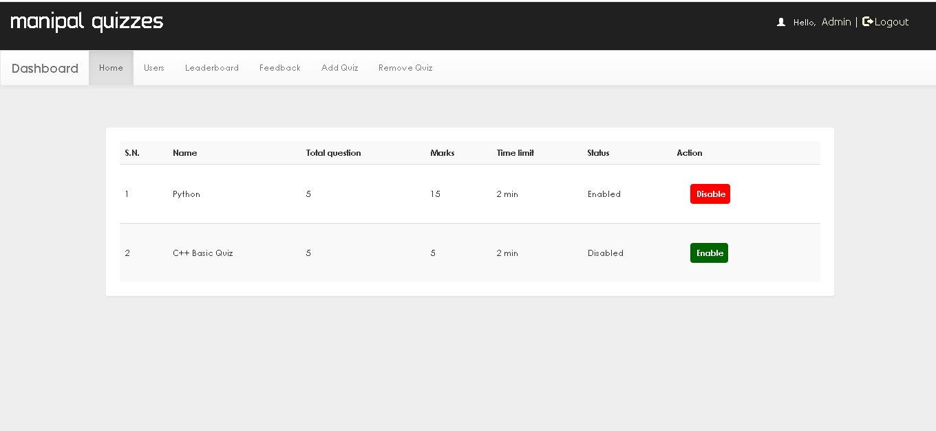
Admin Page

Slide 18
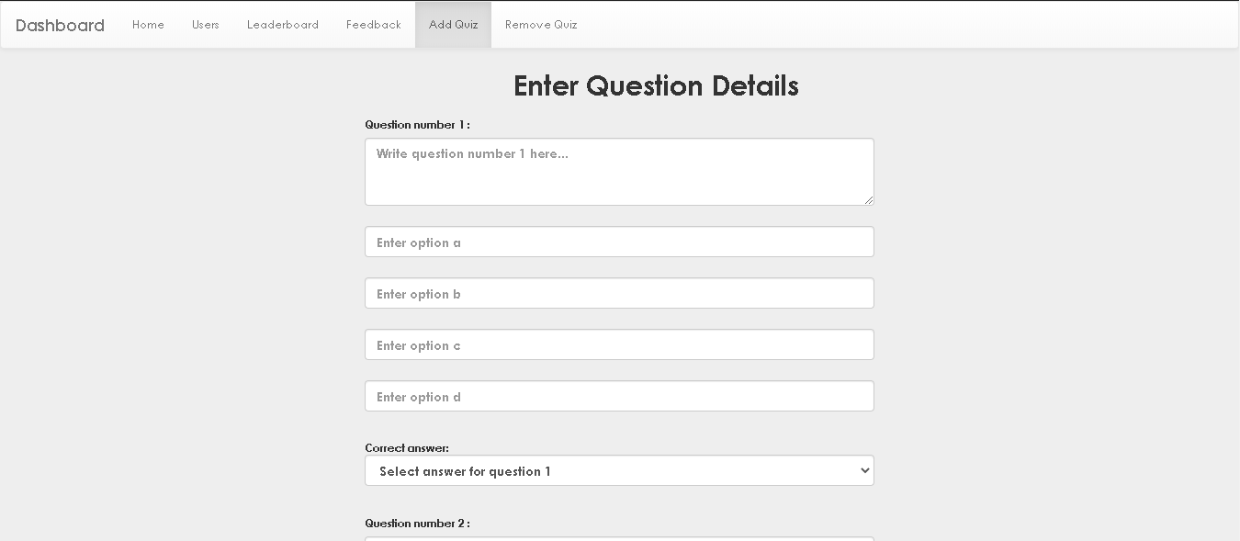
Add Question Page

Slide 19
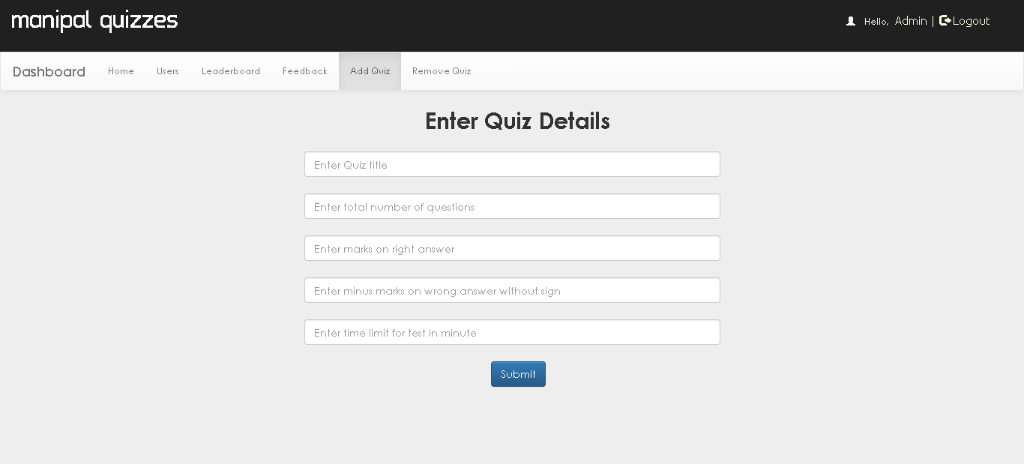
Quiz Creation Page

Slide 20
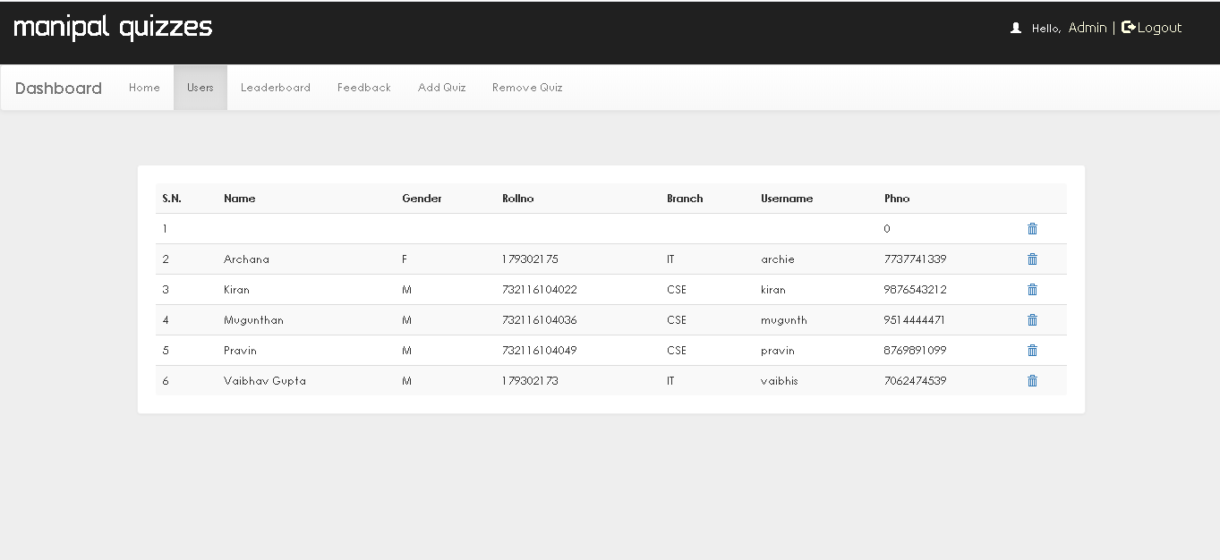
Users Page

Slide 21
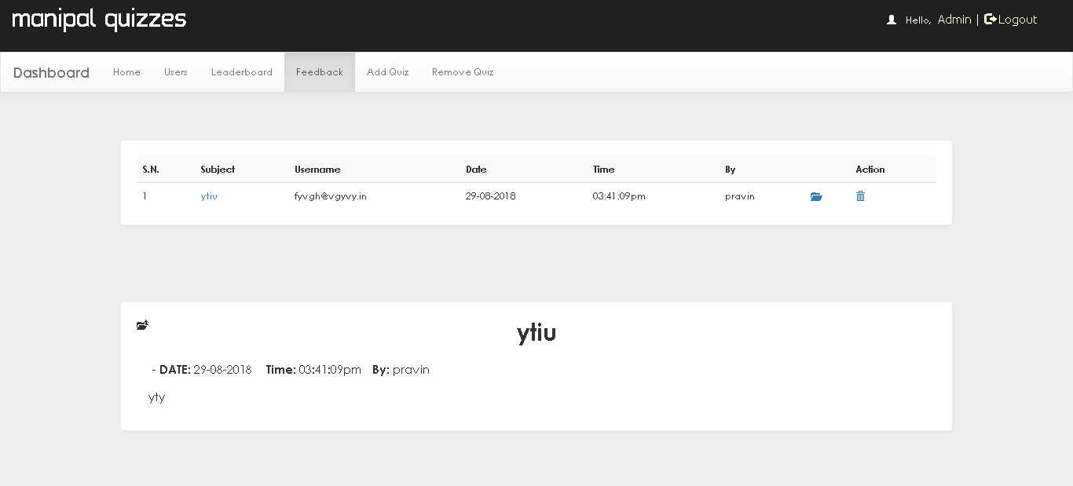
Feedback Page

Slide 22
Implementation
FRONT-END
The Front-end means everything that involved what the user sees. It is converting data to graphical interface for user view and interact with data through digital interaction using HTML, CSS and JavaScript. For developing the Front-end of the project, the languages and frameworks that we used are HTML, CSS, Bootstrap and JavaScript.
BACK-END
The Back-end refers to the server side of a website or an application and everything that communicates between database and the browser. It primarily focused on how the 27 site works. Making updates and changes in addition to monitoring functionality of the site. For developing the Back-end of the project, the languages that we used are Php and MySql

Slide 23
REFERENCES
https://developer.mozilla.org/en-US/docs/Web/JavaScript //learnt basics about javascript from this site.
https://www.youtube.com/watch?v=F5mRW0jo-U4 //free code camp (youtube videos for learning).
https://www.youtube.com/watch?v=OTmQOjsl0eg //Telusko (youtube video for learning).
https://www.w3schools.com/js/default.asp //reading material.

